Slide 1



Explainable Machine Learning
Ioannis Mollas
iamollas@csd.auth.gr
2019

Slide 2


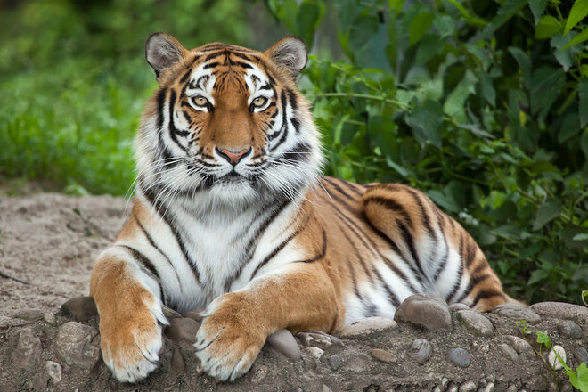

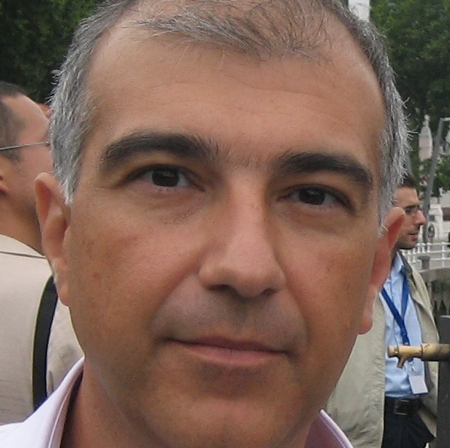
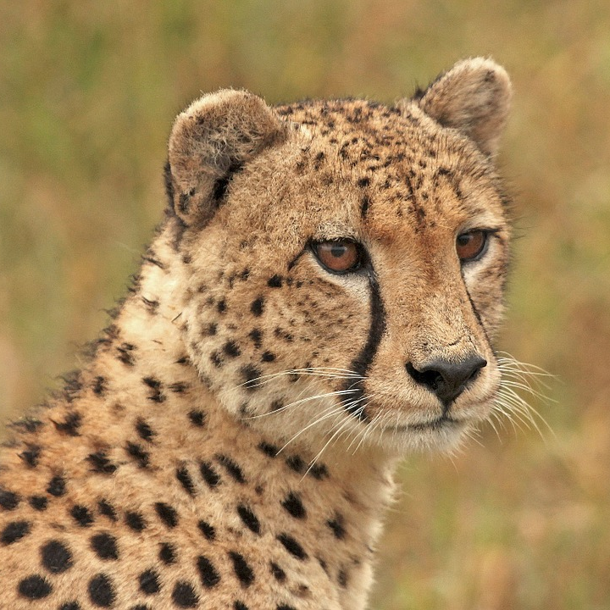

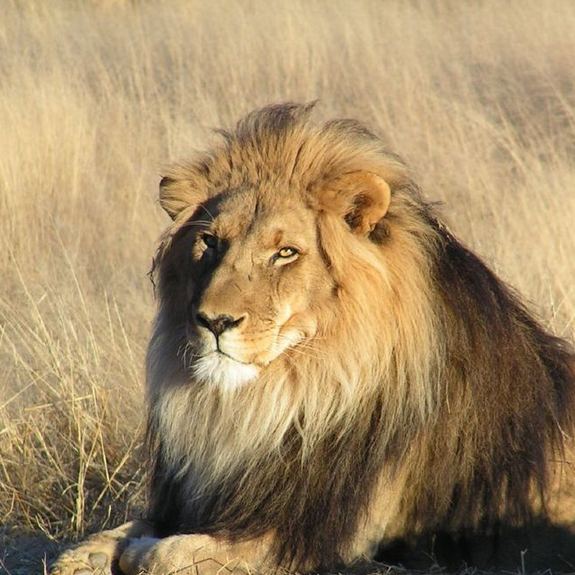



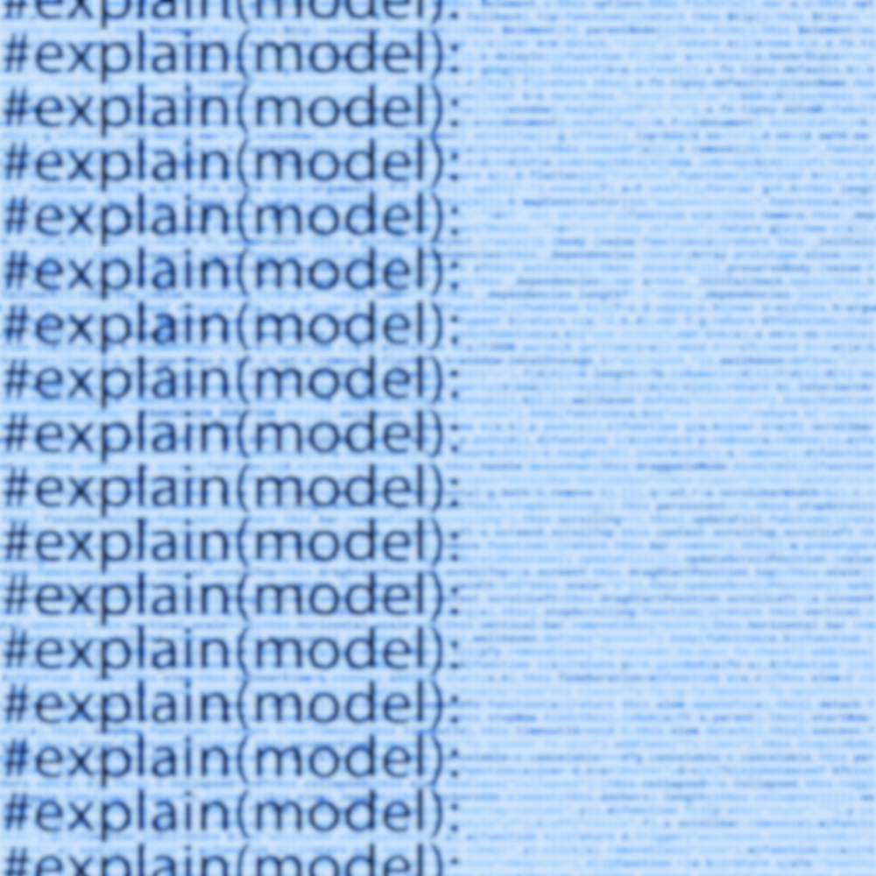
Our Team
This project has received funding from the European Union's Horizon 2020 research and innovation program under grant agreement No 825619.
Ioannis Vlahavas
Professor
Nick BassiliadesProfessor
Grigorios Tsoumakas
Assistant Professor
Ioannis Mollas
PhD Student

Slide 3
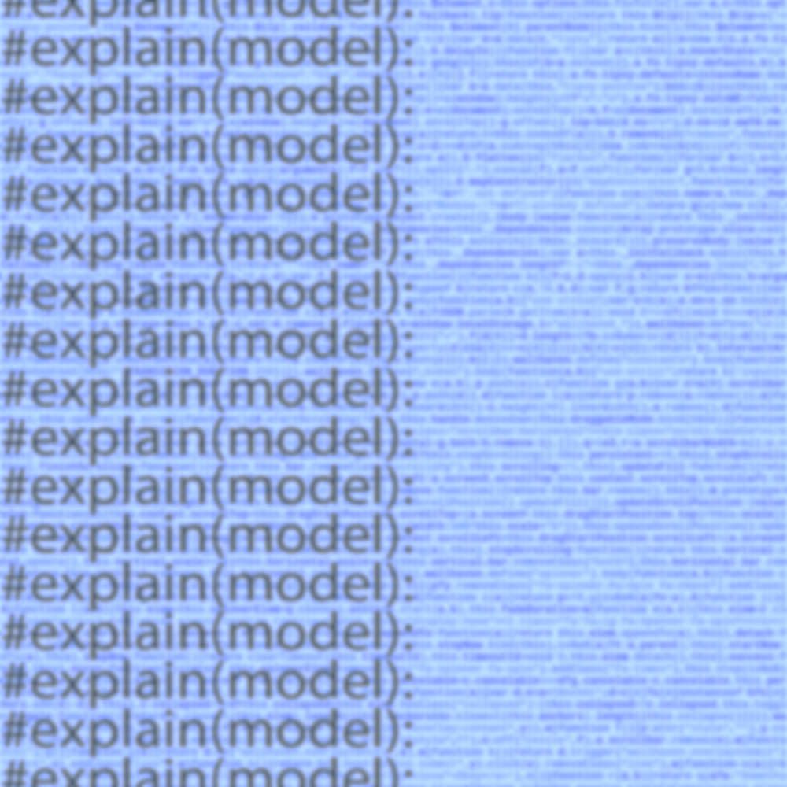
Outline
Transparent and Black Box Models
Explainable ML
Types of Data
Opening the Black Box
Implementations
Tutorial

Slide 4
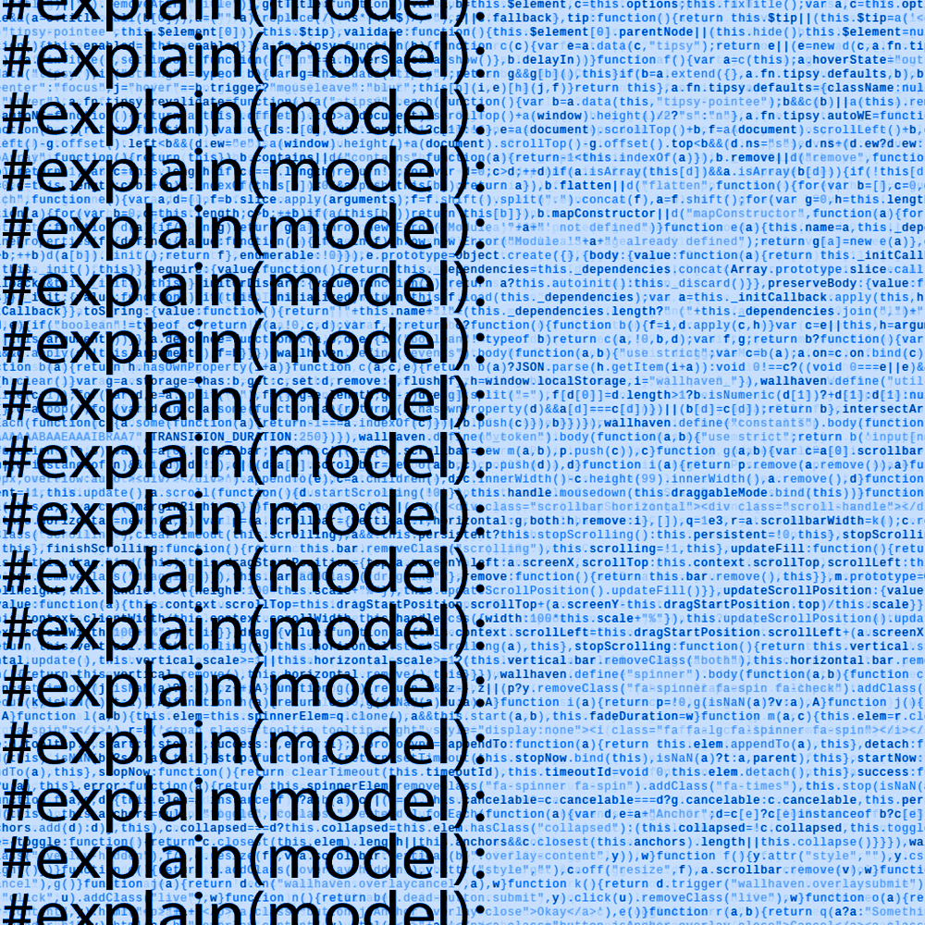
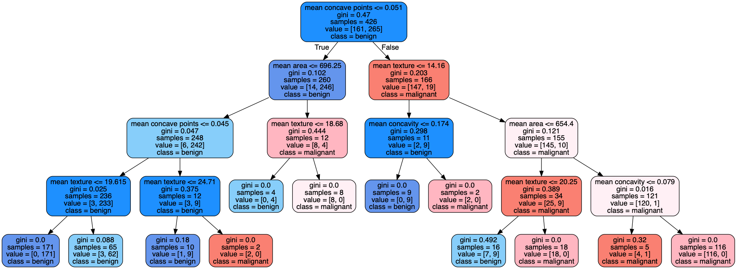
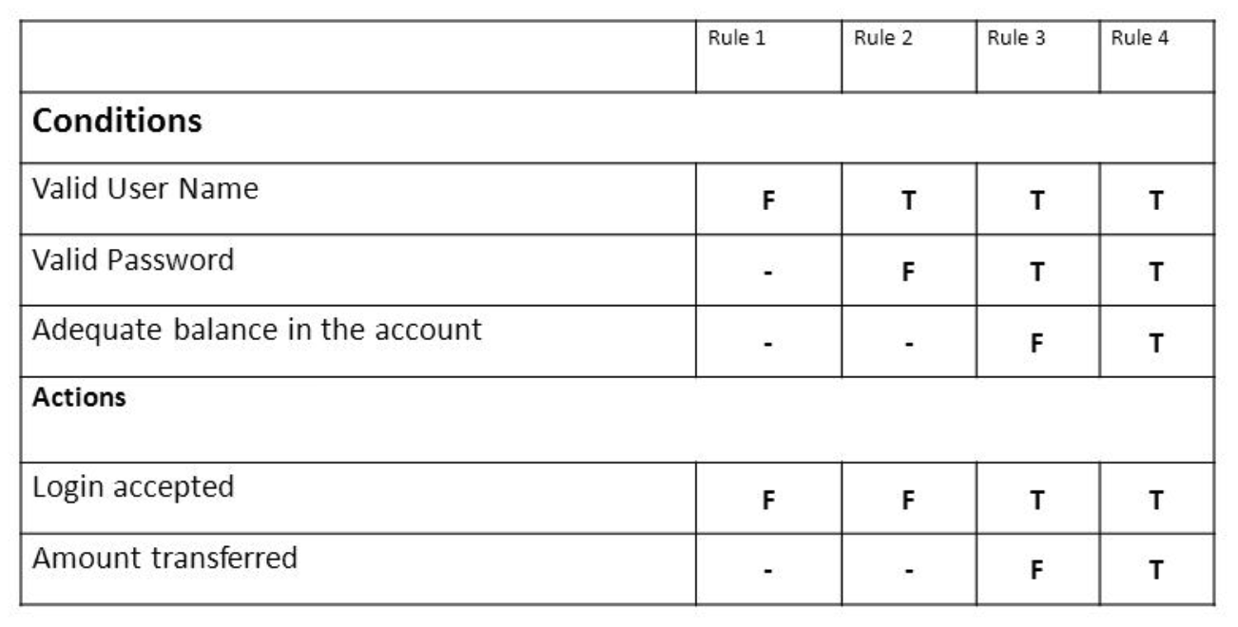
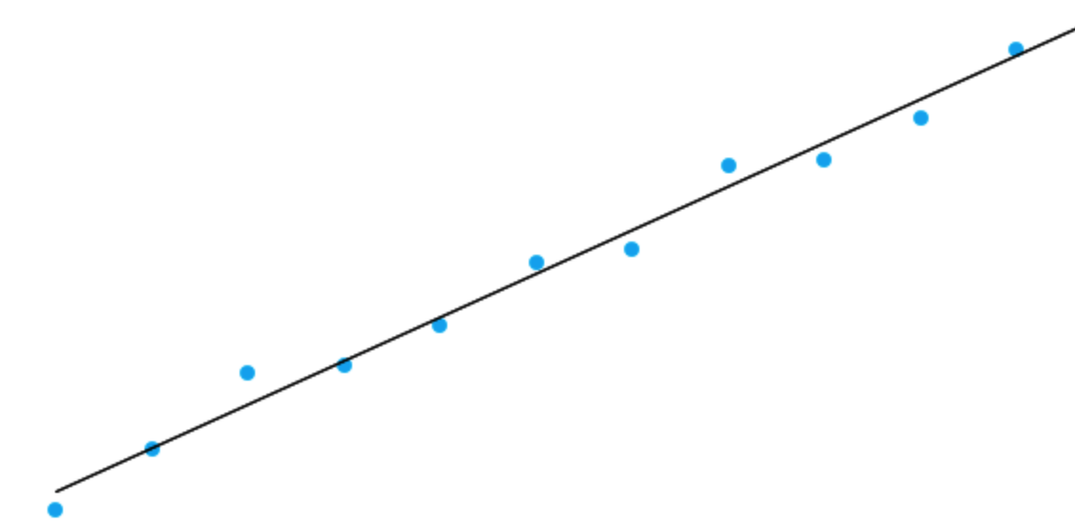
Recognized Interpretable Models
Or Transparent Boxes:
Decision Trees
Rule Based Systems
Decision Tables
Linear Models
Decision Sets
K-NN
IF Proline>=990.0 THEN Wine=1
IF Color intensity<=3.85 AND Color intensity<=3.52 THEN Wine=2
IF Flavanoids<=1.41 AND Proline>=470.0 THEN Wine=3
IF Proline>=680.0 AND Alcohol>=12.93 THEN Wine=1
IF Hue>=0.69 THEN Wine=2
IF TRUE THEN Wine=2
Accepted
Rejected

Slide 5


Black Box Predictor... Means?
A black box predictor is the result of a machine learning algorithm, whose internals are:
known to his creator or
unknown to his creator
and uninterpretable to other people.
“Magic model on the core,
Explain yourself in front of all”
Some known black box models are: Support Vector Machines, Neural Networks, Tree Ensemble, Deep Neural Networks and Non-Linear Models

Slide 6


Meaning Of Explainable ML
1. “A way to present the result of a black box model in human readable terms”^{[1]}
2. “Explainable (Interpretable) ML refers to methods and models that make the behavior and predictions of machine learning systems understandable for humans”^{[4]}
Each community addresses this meaning from a different perspective

Slide 7
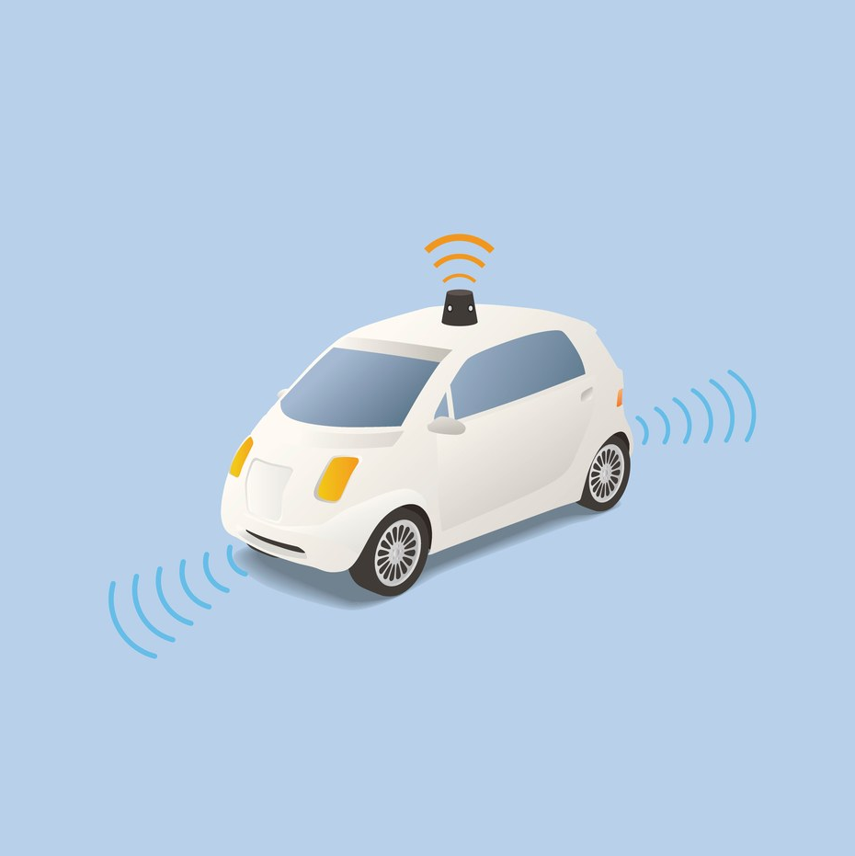





Where we need Explainable ML
Health Care &
Personalized Medicine
Self Driving
Cars & Smart Cities
Credit Scores &
Financial Information
Etc.
Robotic Assistants
GDPR Regulation:
‘Right to Explanation”
User’s Trust,
Miss Classification,
Result Understanding
«At the individual level, designers have both ethical and legal responsibilities to provide such justification for decisions that could result in death, financial loss, or denial of parole.»,
Don Monroe 2018^{[3]}

Slide 8

Dimensions of Interpretability
1. Is it Global or Local?
2. Has Time Limitation?
3. Which is the Nature of User Expertise?
4. Which is the Shape of Explanation?

Slide 9
Desired Features of Explainable Model
Accuracy:
Measuring the accuracy and other metrics of the model
Responsiven-ess :
Measuring the time for explaining an instance
Interpretability:
Measuring Comprehensibility of model
Fidelity:
Measuring the imitation of the black box
Other:
Fairness, privacy, usability, reliability, robustness and scalability

Slide 10
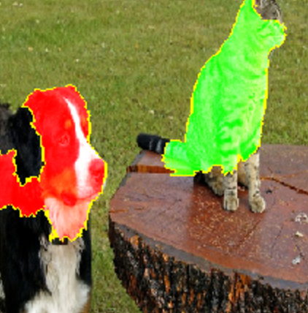
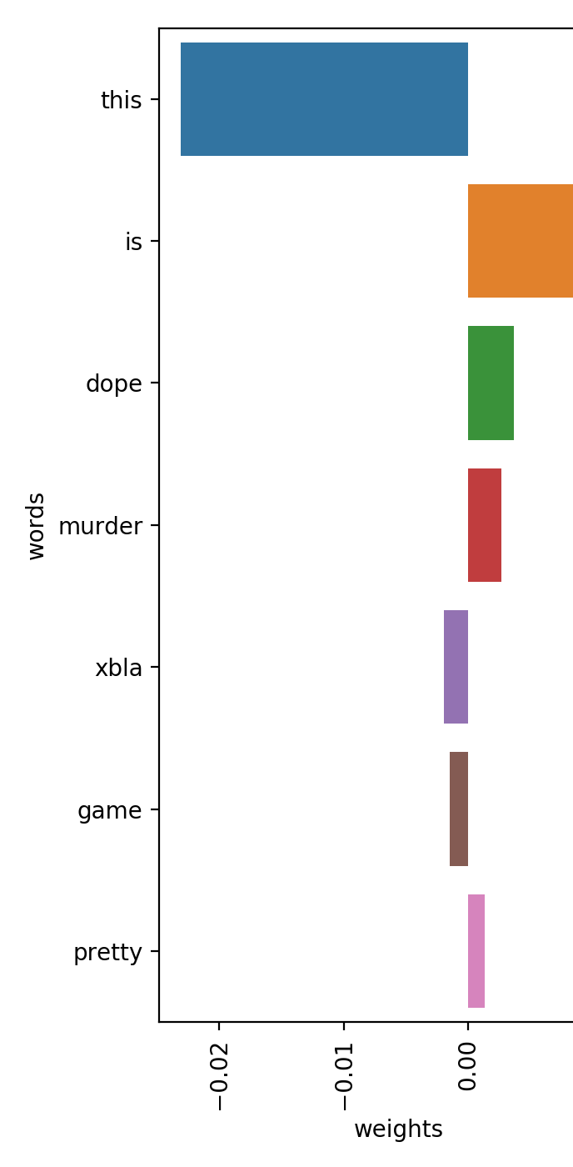
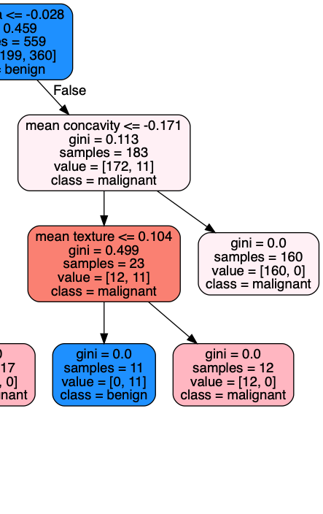
IF Proline>=990.0 THEN Wine=1
IF Color intensity<=3.85 AND Color intensity<=3.52 THEN Wine=2
IF Flavanoids<=1.41 AND Proline>=470.0 THEN Wine=3
IF Proline>=680.0 AND Alcohol>=12.93 THEN Wine=1
IF Hue>=0.69 THEN Wine=2
IF TRUE THEN Wine=2
Why did you predict that?
Because of $Arg0$
Attacking Arg1
Attacking Arg3
But this $Arg1$ is valid too!
That’s true, but $Arg2$ defends $Arg0$!
Textual Form
Visual Form
Graphical Form
Dialectical Form
Shapes of Explanations

Slide 11
Comprehensibility Measure^{[2,6]}
Human Centered Evaluation
Number of regions (parts of the model)
Number of conditions (in a rule)
Number of non-zero weights (in linear models)
Depth of the tree (in a decision tree)
Simplification Methods like pruning are used in order to enhance the comprehensibility and to avoid overfitting.
But do we want to avoid overfitting when explaining?

Slide 12
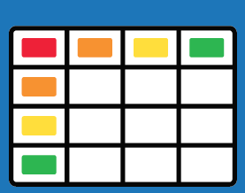


Types of Data
Tabular Data
Image Data
Text Data

Slide 13
Opening the Black Box
Reverse Engineering on Black Box
Model Explanation
Outcome Explanation
Model Inspection
Explanation for Fixed Dataset or Capable to Explain new Examples
Agnostic
Explanators?
Replace with Transparent Box

Slide 14
Can explain indifferently any kind of Black Box in most of the papers
Most of the times, It has a specific type of data (Tabular, Images, Texts, Other), but rarely It could be agnostic on type of data too
Some Advantages of Agnostic Explanators:
They can explain models, even without dataset knowledge
They can explain models remotely
Agnostic Explanator?

Slide 15
Model Explanation:
Is aimed at understanding the overall logic behind the black box. Provides a global explanation, through a transparent box.
Examples: Surrogate Method Explanators, Knowledge Distillation
Reverse Engineering on Black Box
Outcome Explanation:
Is aimed at understanding the outcome of an instance. Provides a local explanation, through a transparent box.
Examples: Lime, Anchors
Model Inspection:
Provides a visual or textual representation of some specific properties.
Examples: Permutation Importance, PDP, ICE, SHAP

Slide 16





Surrogate or Meta-Learner Method^{[7]}
P
Reverse Engineering on Black Box
Training
Predicting
Training
Oracle Data
(X, y_predicted, X_test y_predicted_test)
Train Data
(X,y)
Train and Test Data
(X,X_test)

Slide 17





Use of Scikit
Learn for Explainable Models
https://scikit-learn.org
TP
Decision Tree or Linear Model
explanation
Surrogate method
Global or Local
Use of Orange for Explainable Models
https://github.com/biolab/orange3
IF Proline>=990.0 THEN Wine=1
IF Color intensity<=3.85 AND Color intensity<=3.52 THEN Wine=2
TP
CN2 – Rule Based
explanation
Surrogate method
Global or Local

Slide 18

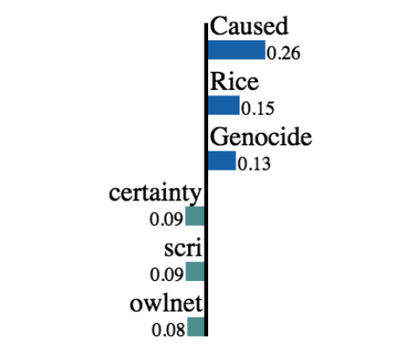
New Instance
creates
Synthetic Neighborhood: by removing words from the instance randomly
LIME^{[5]}
State of the Art
audits
P
local interpretable model-agnostic explanations
https://github.com/marcotcr/lime
predicts
Mathematic Formulation
L(f, g, πx) + Ω(g)
TP
Linear Model
trains
Final explanation

Slide 19
Permutation Importance^{[4]}
P
Reverse Engineering on Black Box
Training
Audit
New Data
Randomize a feature
Train Data
(X,y)
Inst. | F1 | F2 | F3 | FN | Predicted
x1 | 0 | 1 | blue | warm | 0
x2 | 1 | 1 | red | cold | 1
x3 | 0 | 0 | blue | cold | 1
Inst. | F1 | F2 | F3 | FN | Target
x1 | 0 | 1 | blue | cold | 1
x2 | 1 | 1 | red | warm | 0
x3 | 0 | 0 | blue | cold | 1
Inst. | F1 | F2 | F3 | FN | Predicted
x1 | 0 | 1 | red | cold | 1
x2 | 1 | 1 | blue | warm | 0
x3 | 0 | 0 | blue | cold | 1

Slide 20
PDP (Partial Dependence Plot)^{[4]}
P
Reverse Engineering on Black Box
Training
Audit
New Data
Train Data
(X,y)
Inst. | F1 | F2 | F3 | FN | Predicted
x1 | 0 | 1 | blue | cold | 1
x2 | 1 | 1 | red | cold | 1
x3 | 0 | 0 | blue | cold | 1
Mean Prediction
Inst. | F1 | F2 | F3 | FN | Target
x1 | 0 | 1 | blue | cold | 1
x2 | 1 | 1 | red | warm | 0
x3 | 0 | 0 | blue | cold | 1
Inst. | F1 | F2 | F3 | FN | Predicted
x1 | 0 | 1 | blue | warm | 0
x2 | 1 | 1 | red | warm | 0
x3 | 0 | 0 | blue | warm | 1

Slide 21
SHAP/Shapley Value ^{[4]}
P
Reverse Engineering on Black Box
Training
Audit
New Data
Inst. | F1 | F2 | F3 | FN | Predicted
x1 | 0 | 1 | blue | cold | 1
x2 | 1 | 1 | red | cold | 0
x3 | 0 | 0 | blue | cold | 1
Train Data
(X,y)
Inst. | F1 | F2 | F3 | FN | Predicted
x1 | 0 | 1 | blue | cold | 1
x2 | ? | ? | ? | cold | ?
x3 | ? | ? | ? | cold | ?
Inst. | F1 | F2 | F3 | FN | Target
x1 | 0 | 1 | blue | cold | 1
x2 | 1 | 1 | red | warm | 0
x3 | 0 | 0 | blue | cold | 1
Inst. | F1 | F2 | F3 | FN | Predicted
x1 | 0 | 1 | blue | cold | 1
x2 | 1 | 1 | blue | warm | 1
x3 | 0 | 0 | blue | cold | 1
Inst. | F1 | F2 | F3 | FN | Predicted
x1 | 0 | 1 | blue | cold | 1
x2 | ? | ? | blue | ? | ?
x3 | ? | ? | blue | ? | ?

Slide 22
Knowledge Distillation^{[8]}
Using Transparent boxes to mimic black boxes’ accuracies
Output Layer
…
New Train Data from Labeled and Unlabeled Data annotated by the deep neural network are used to train the “Student”
…
Reverse Engineering on Black Box
Explainable Model
…
…
…
Input Layer
Training a high-accuracy deep neural network as
“Teacher”
Train Data
(X,y)
Unlabeled Data

Slide 23
Existing XML Libraries
Scikit
Learn
Orange
Skater
SHAP
Eli5
+ Others

Slide 24
Bibliography
Riccardo Guidotti, Anna Monreale, Salvatore Ruggieri, Franco Turini, Dino Pedreschi, Fosca Giannotti. 2018. A Survey Of Methods For Explaining Black Box Models.
Amina Adadi and Mohammed Berrada. 2018. Peeking Inside the Black-Box: A Survey on Explainable Artificial Intelligence (XAI).
Don Monroe. 2018. AI, Explain Yourself.
Christoph Molnar. 2018. Interpretable Machine Learning.
Marco Tulio Ribeiro, Sameer Singh, Carlos Guestrin. 2016. "Why Should I Trust You?": Explaining the Predictions of Any Classifier.
Johan Huysmans, Karel Dejaeger, Christophe Mues, Jan Vanthienen, and Bart Baesens. 2011. An empirical evaluation of the comprehensibility of decision table, tree and rule based predictive models.
Pedro Domingos. 1998. Knowledge Discovery Via Multiple Models
Geoffrey Hinton, Oriol Vinyals, Jeff Dean. 2015. Distilling the Knowledge in a Neural Network

Slide 25


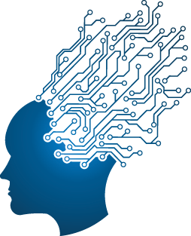
Demo Time

Slide 26

Before we go…
I Say…
Others say: Future is New Models, Interpretable by Design
Some say: Future Is Model Agnostic Models

Slide 27


The End
Explainable Machine Learning
BB
“Magic model on the core,
Explain yourself in front of all”
TB
PS: Tutorials and Examples in a while
Ioannis Mollas
iamollas@csd.auth.gr
Notes:
Ευχαριστώ για την προσοχή σας.
Ελπίζω να έγινε κατανοητό το Explainable ML.

